Slide 1
CT290DS-003 (10)
Python Django Project
By: Gordon Chu
2024-10-10

Slide 2
Development Environment
The web site was developed in a virtual environment running Python 3.10.14 and Django 4.2
Repository is Github at https://github.com/njflash88/penguinpj.
Database is Postgres SQL16.4

Slide 3
Extending UserManager (django.contrib.auth.models)
We intended to use email for user name to create user account. In order to do that, we created an app call authuser with a model User that use another model CustomUserManager that contain the basic Django create user and superuser functions. But later decided to use create a one to one mapping of the Students model to the User model using the User Name field.
So actually we are still using the internal Django logon functions to manage the user session but extended the Student databasen with more students fields.

Slide 4
Project Description
The project was to create a website for a open source centric consulting software company, which promote open source system and provide development service and education courses.
Enrolled students can check their enrolled courses detail at the dashboard and enrolled for more courses. A forum service is provided for students to create and collaborate on a specific forum which other student can contribute and post messages.

Slide 5
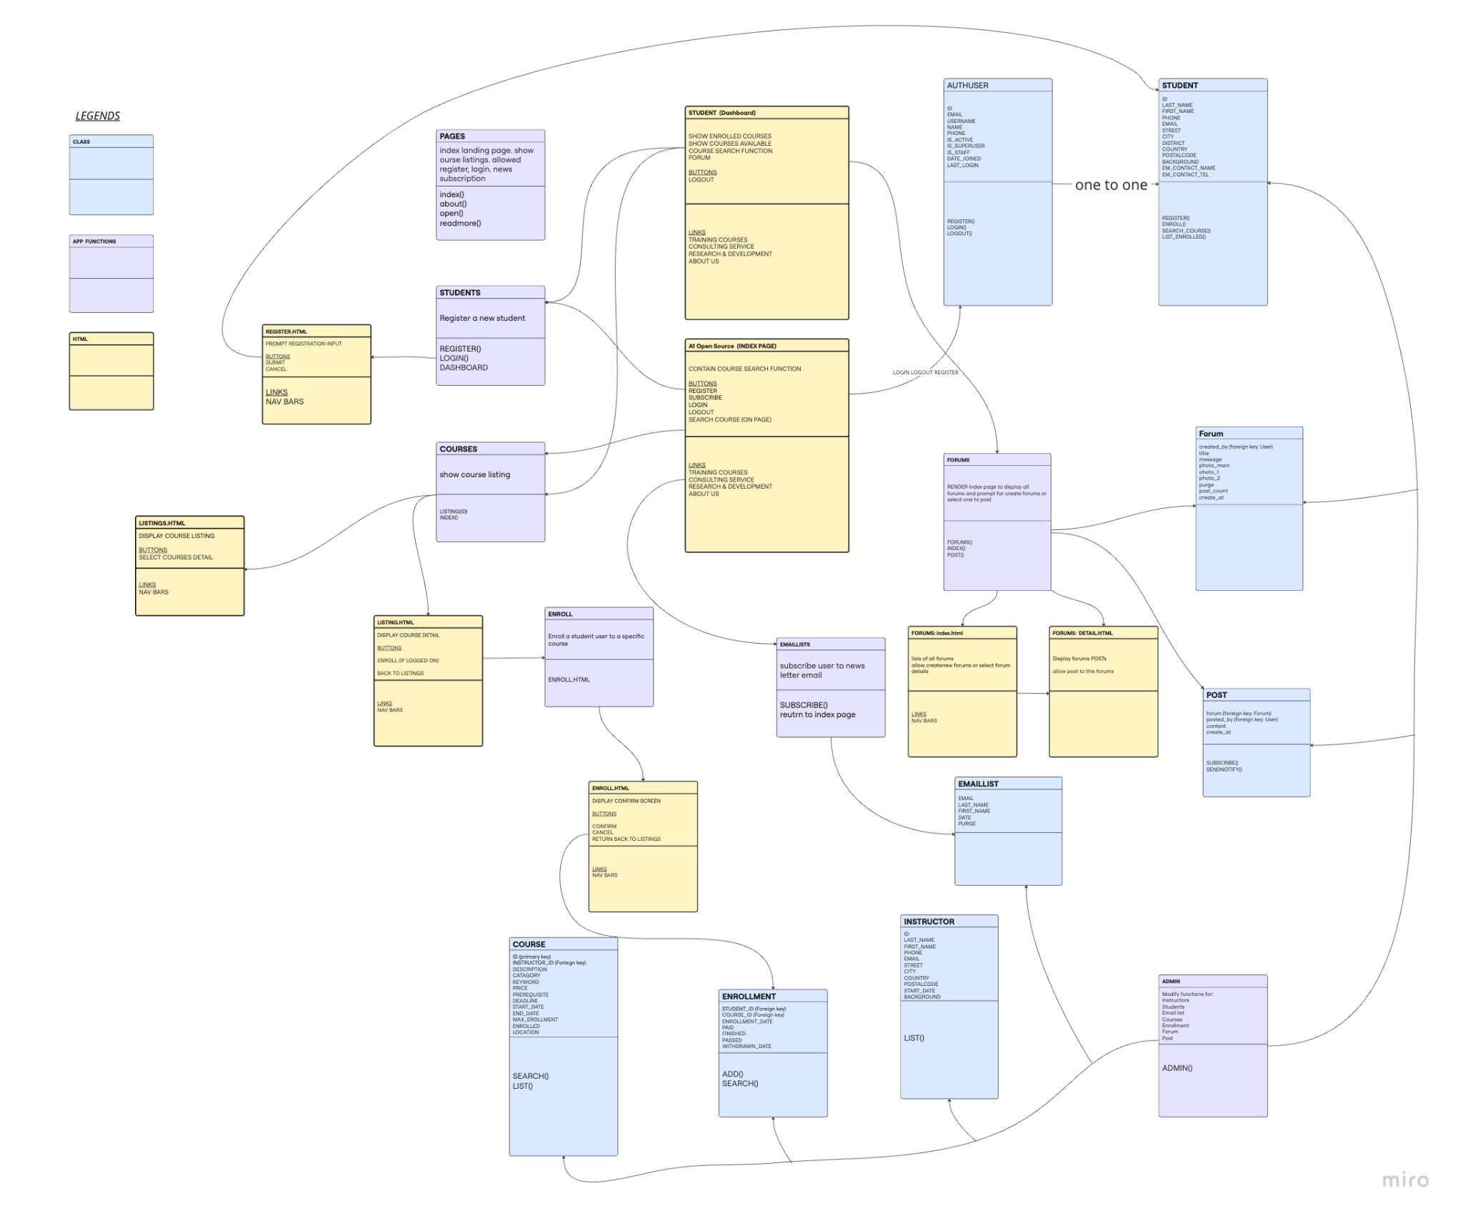
UML
UML diagrams and classes are among the first few things to create in the earliest stage. Followed by the logical flow of the website.

Slide 6
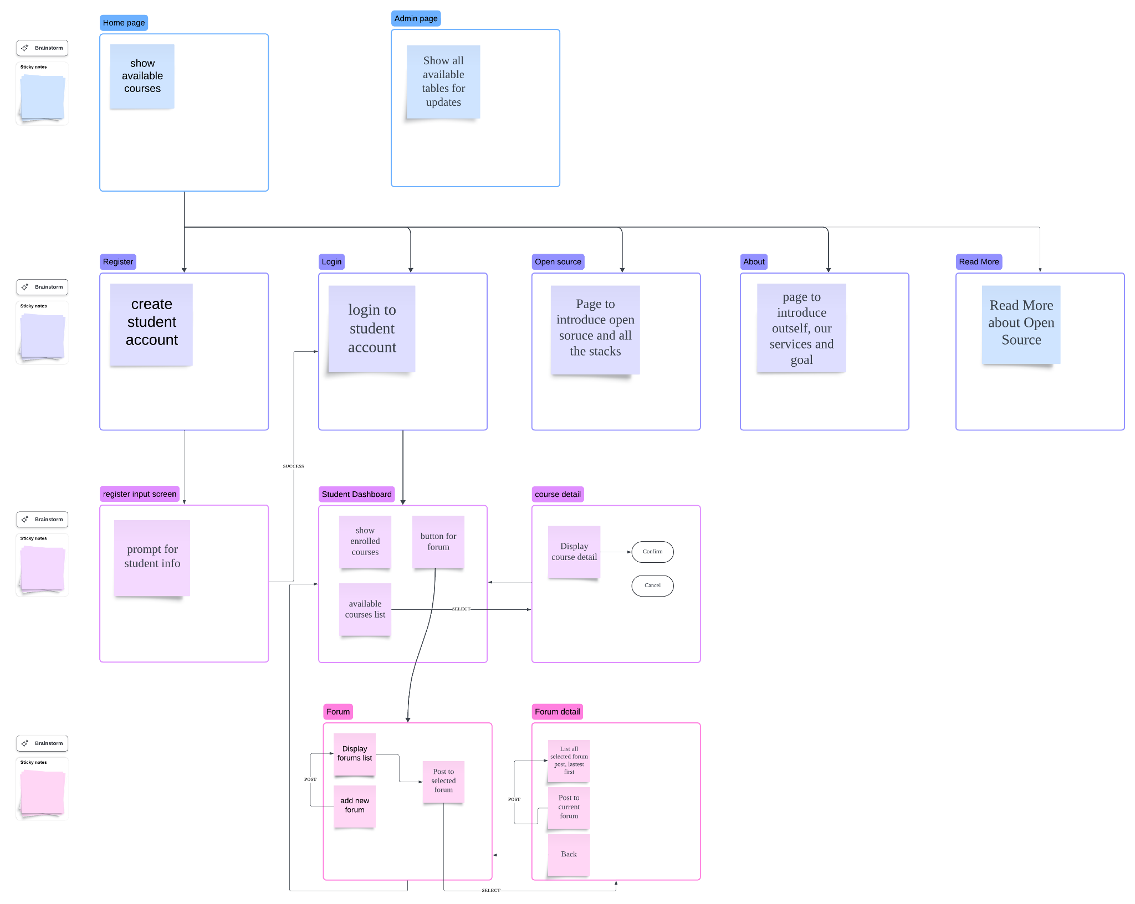
Page flow

Slide 7
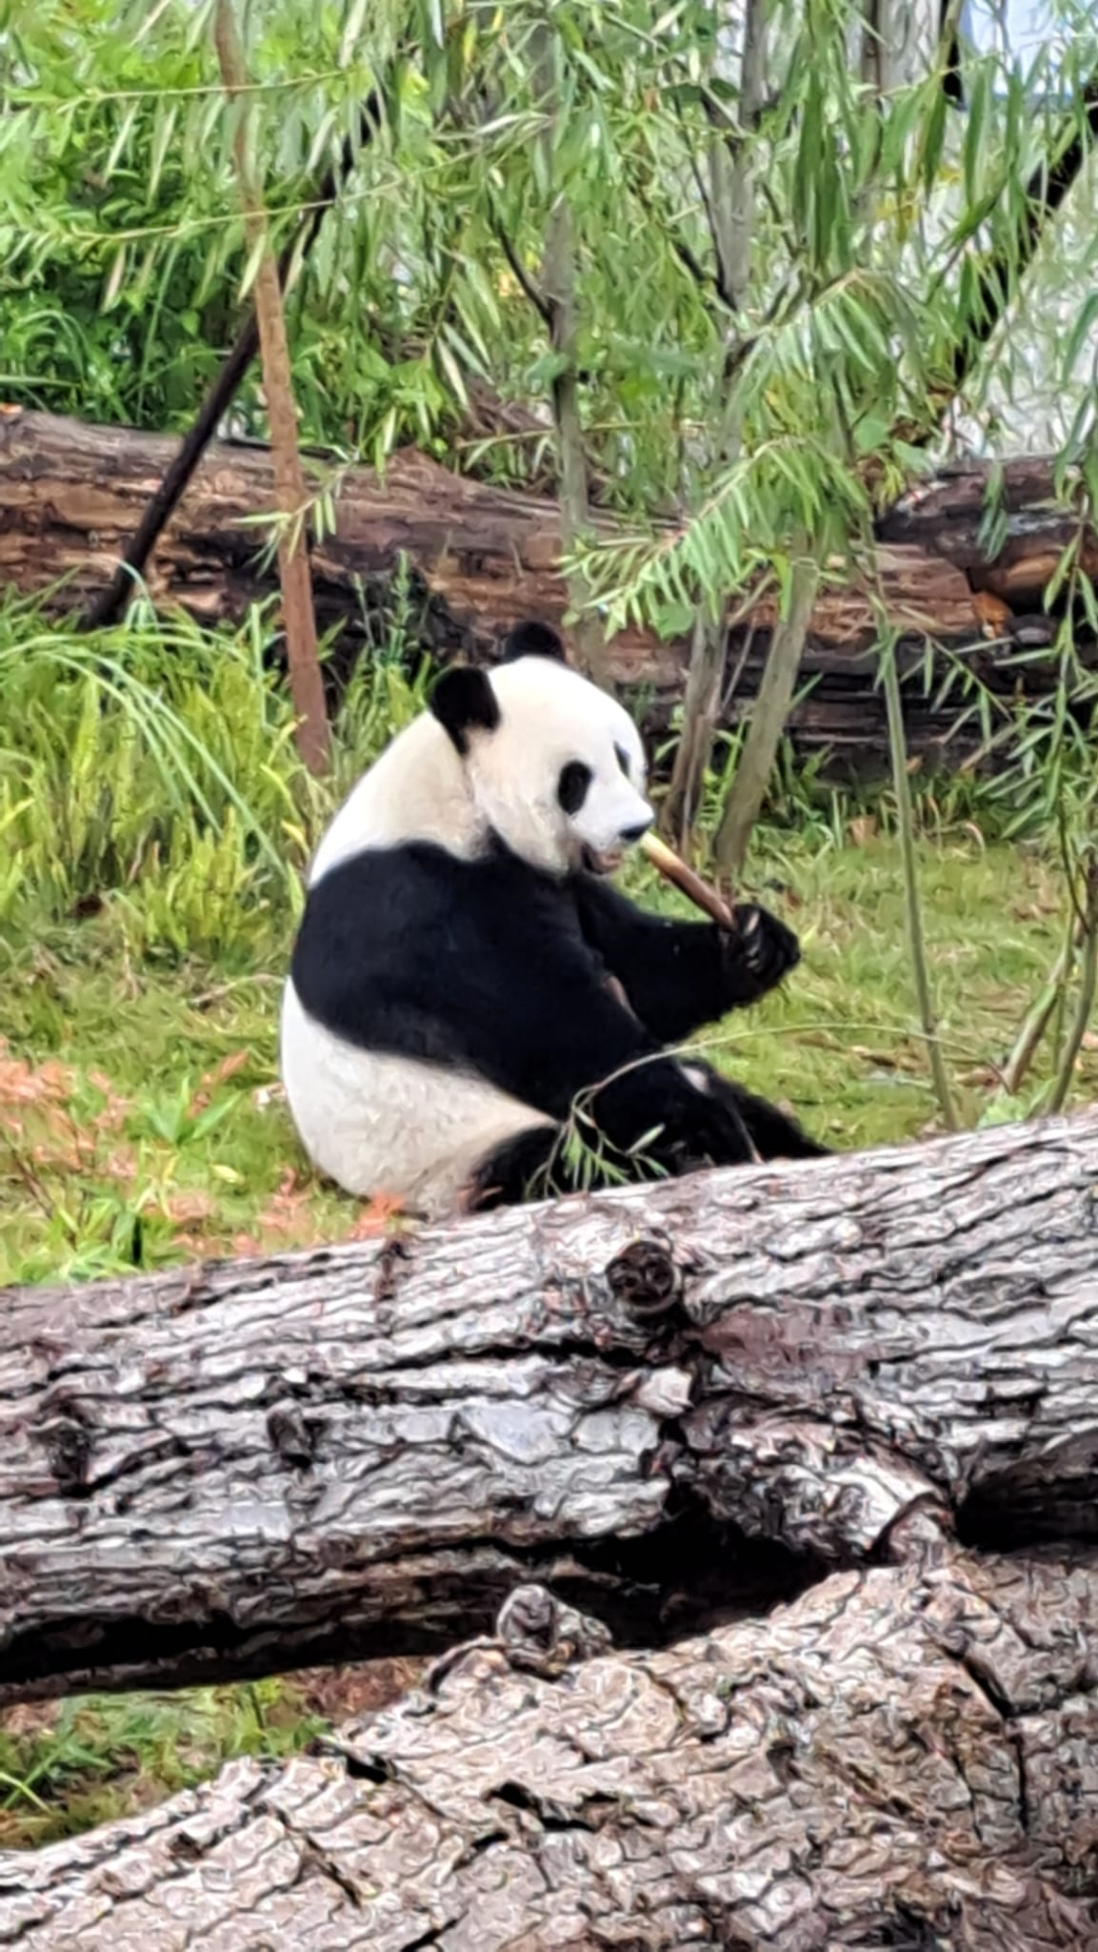
Finish!
Gateway to Python world
Web based development
AI Capability and going beyond…
Good Luck to your future exploration!

